Slide 1



Secure Company Network System
Members :
Company : AST

Slide 2


Secure Company Network System
This project aims to design and configure a robust, scalable, and secure network infrastructure for a corporate environment. The scope includes core networking components such as routers, switches, firewalls, and VLANs to enable efficient communication and security between internal and external systems.

Slide 3

Project Objectives
1
Scalability
2
Reliability
Ensure the network can accommodate future growth and increased demands without performance degradation.
Implement redundancy and failover mechanisms to maintain consistent connectivity and uptime.
3
Security
4
Efficiency
Enforce robust security policies and controls to protect against unauthorized access and cyber threats.
Optimize network resource utilization and minimize operational overhead through automation and centralized management.

Slide 4
Network Design Principles
Modularity
Redundancy
Security
Adopt a modular approach to network design, allowing for easy scalability, maintenance, and troubleshooting.
Implement redundant network components and paths to ensure high availability and failover capabilities.
Integrate security best practices, such as firewalls, access control, and encryption, to protect against threats.

Slide 5
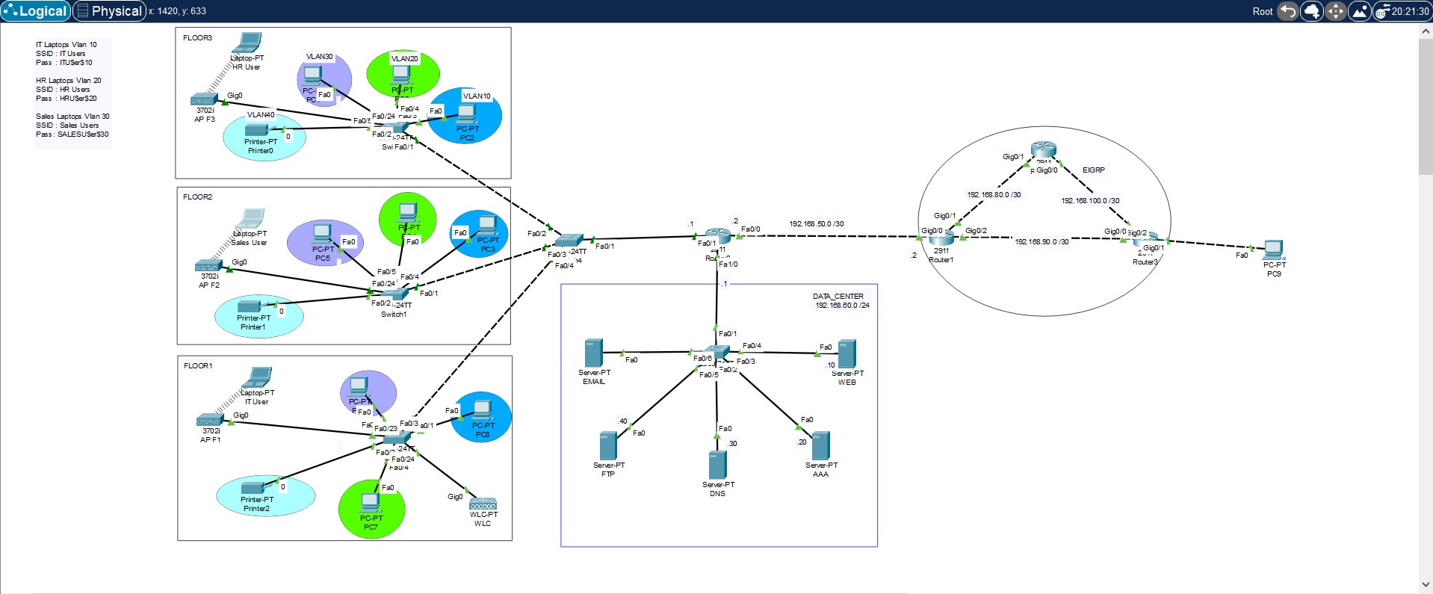
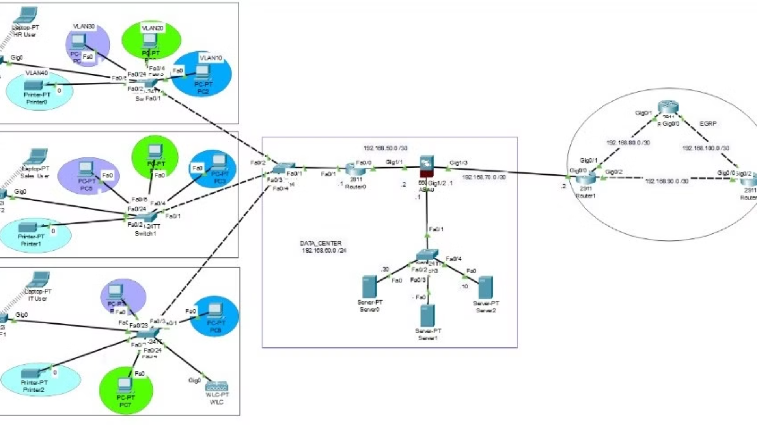
Secure Company Network System
The diagram illustrates the corporate network infrastructure, including three VLANs (IT(VLAN 10),HR(VLAN 20),IS(VLAN 30),Printer(VLAN 40))with respective access points, laptops, and inter-VLAN routing configuration.
The Wireless LAN Controller (WLC) manages the wireless access points across different floors, providing DHCP services for each department's network

Slide 6


Hardware Components and Topology
Core Routers
Access Switches
Datacenter
Layer 2 switches that provide connectivity to end-user devices and support features like Power over Ethernet (PoE).
DNS Server
File Server
AAA Server
WEB Server
High-performance routers that handle inter-VLAN routing and provide connectivity to the internet.
1
2
3
4
5
VTP Switch
Wireless Network Expansion
Layer 3 switches that aggregate traffic from access switches and enable VLAN segmentation.
the WLC configuration ensures that laptops and mobile devices across different floors and departments can connect securely to their designated VLANS.

Slide 7
Inter-VLAN Routing Configuration
VLAN Creation
Inter-VLAN Routing
Access Control
Wireless Inter-VLAN Routing
Establish logical network segments based on functional or organizational requirements, such as departments or user groups.
Configure core routers to enable communication between different VLANs, ensuring seamless data flow across the network.
Implement access control lists (ACLs) and policies to restrict or allow Telnet traffic between VLANs based on security requirements. The security configuration should permit Telnet access only from VLAN IT (10), with the IP range 192.168.10.0/24.
Access Points on each floor are managed by a WLC, enabling seamless inter-VLAN routing and centralized wireless traffic management for HR, IT, and Sales

Slide 8

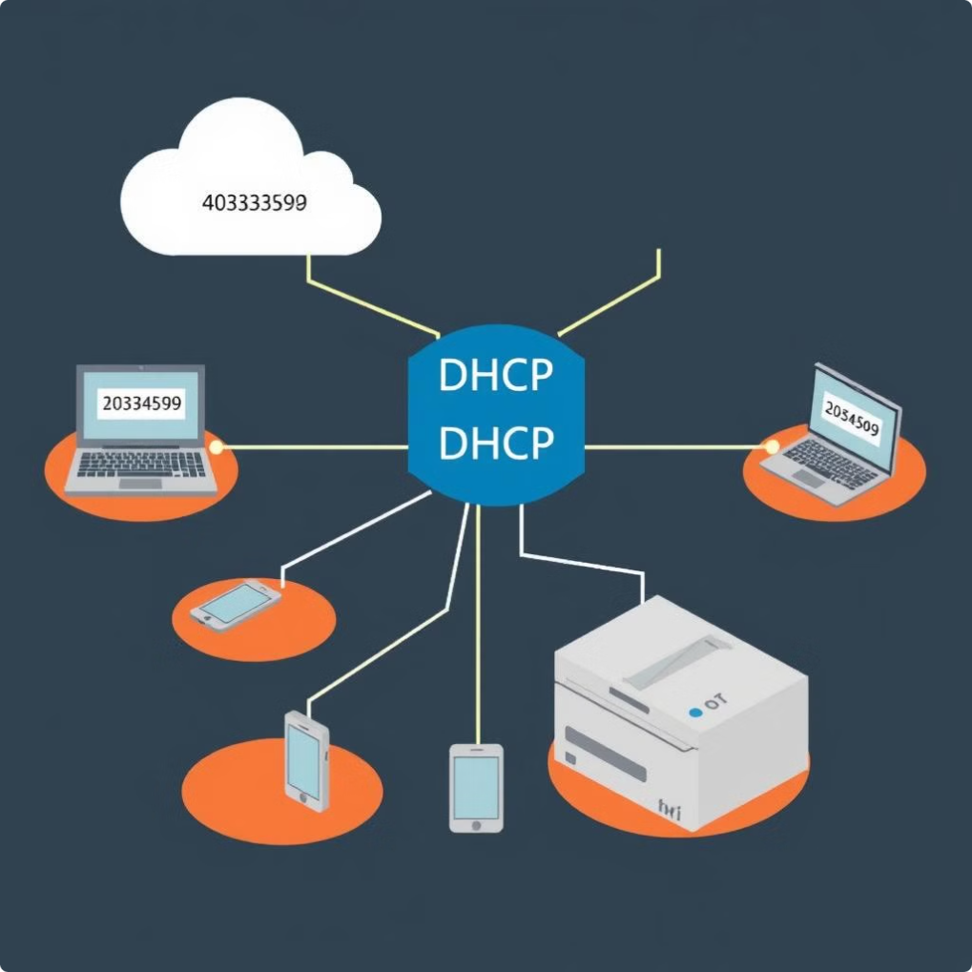
DHCP Services Implementation
DHCP Configuration per Department
IP Address Management
Deploy DHCP servers to automatically assign IP addresses to devices, simplifying network configuration and management.
Each VLAN is assigned a dedicated DHCP scope for dynamic IP allocation, ensuring efficient address management for departmental devices
Scope Configuration
Redundancy
Define DHCP scopes for each VLAN, ensuring appropriate IP address ranges and network parameters are assigned.
Implement multiple DHCP servers for high availability and failover, ensuring IP address assignment continuity.

Slide 9

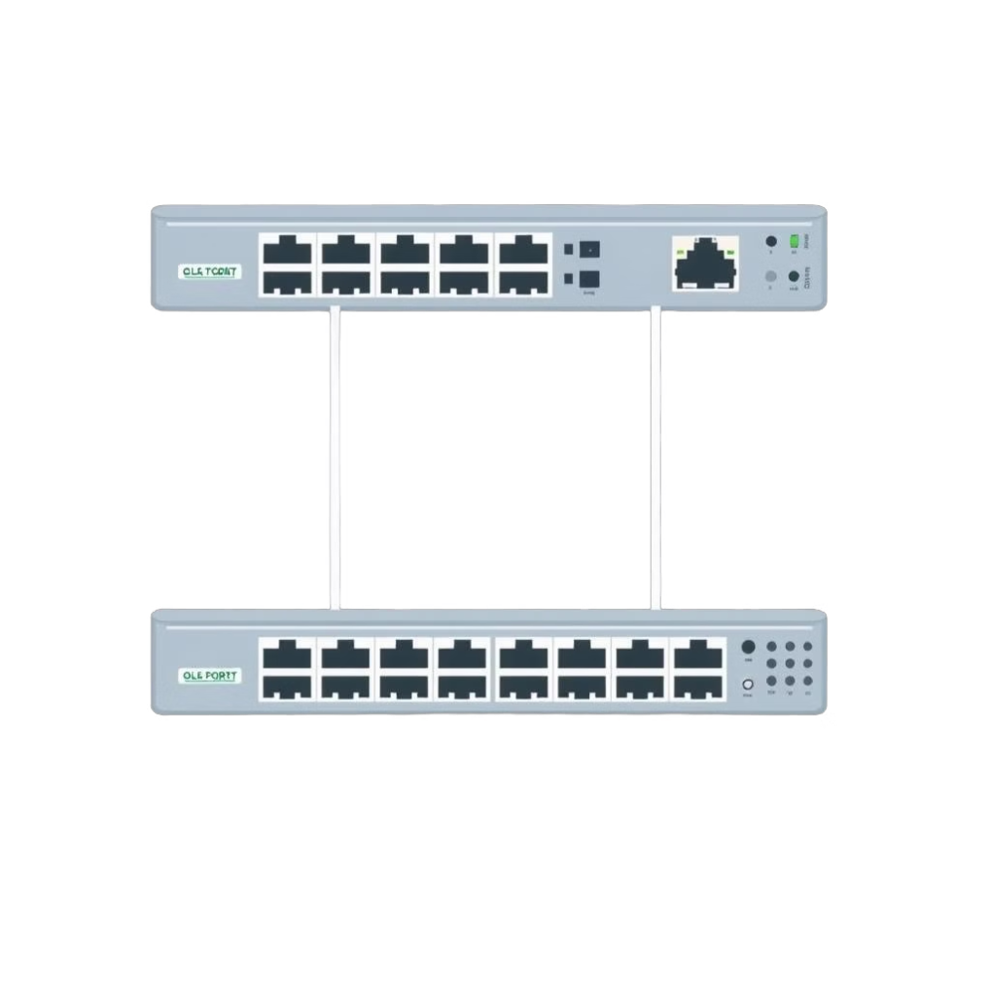



Trunking and Port Configuration
Trunk Ports
Configure trunk ports on switches to carry traffic for multiple VLANs, enabling efficient data transfer between network segments.
Trunk Ports for Wireless VLAN Traffic
Configured trunk ports to support VLAN-tagged traffic for wireless access points, enabling seamless connectivity across departments.
Access Ports
Assign access ports to specific VLANs, ensuring end-user devices are connected to the appropriate network segment.
Port Security
Implement port security measures, such as MAC address limitations and 802.1X authentication, to prevent unauthorized access.

Slide 10





Firewall and Security Policies
Zone-Based-Firewall
Access Control
Deploy enterprise-grade firewalls to control and monitor traffic flow between the internal network and the internet.
Establish granular access control policies to restrict or allow traffic based on source, destination, and application protocols.
Intrusion Detection
Wireless Security Policies
Implement intrusion detection and prevention systems (IDS/IPS) to identify and mitigate security threats in real-time.
Extend security policies to cover wireless networks, ensuring Access Points enforce strict authentication and VLAN separation across departments.

Slide 11
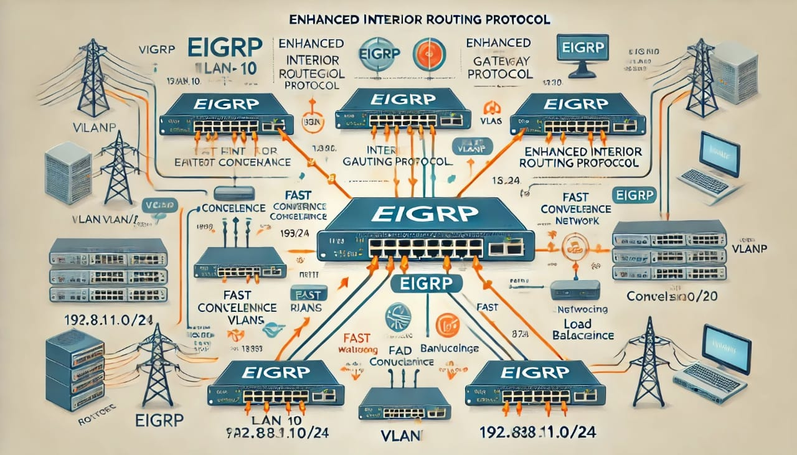
Routing Protocol Selection and Setup
EIGRP
EIGRP (Enhanced Interior Gateway Routing Protocol)
Used in this project for efficient routing between VLANs.
Why EIGRP?
Provides fast convergence, crucial for maintaining network stability.
Supports advanced features like unequal-cost load balancing, optimizing traffic flow.
Easily scales with network growth, suitable for future expansion.
Ideal for networks with redundant paths, ensuring reliable communication.

Slide 12
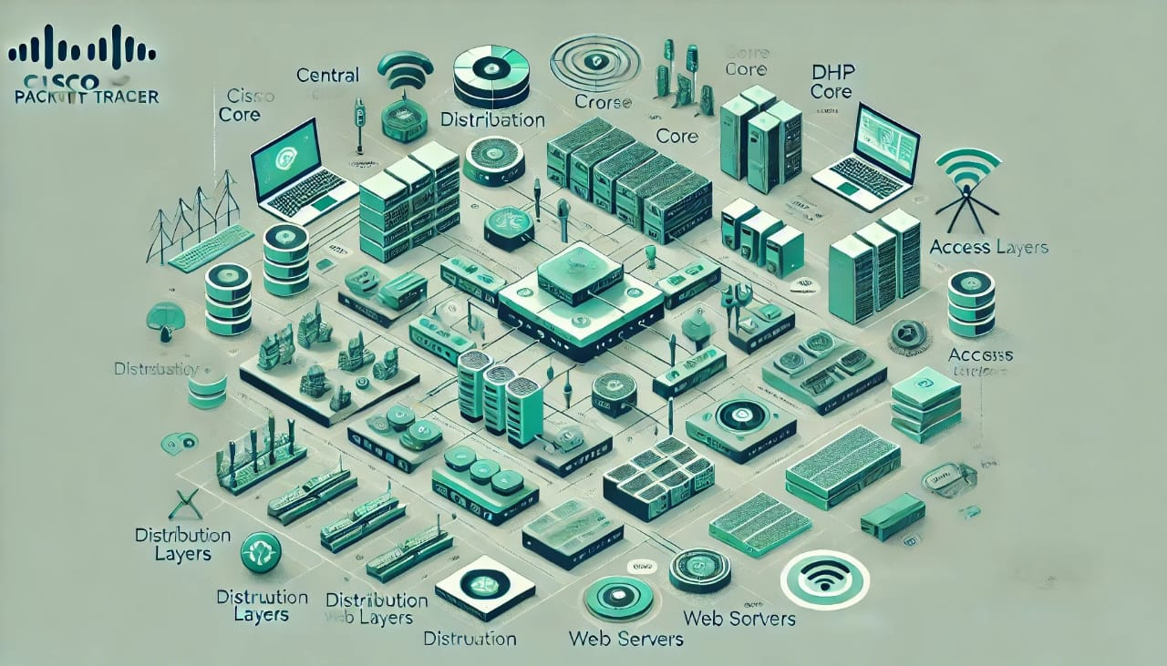
This project successfully outlines the creation of a robust and scalable network infrastructure using Cisco Packet Tracer. By implementing a structured approach with a core, distribution, and access layer, we ensure efficient traffic management and network segmentation. The integration of critical services like DHCP, DNS, web, and file servers with proper IP addressing and security measures, such as Zone-Based-Firewall
And ACLs, provides a secure and manageable environment. Additionally, the inclusion of wireless connectivity with access points and controllers enhances network accessibility and flexibility .By meticulously configuring and testing each component, this network design guarantees reliable connectivity, enhanced security, and efficient resource management. This comprehensive setup serves as a solid foundation for meeting the company's current needs and scaling to accommodate future growth and technological advancements.

